Slide 1
Software
Jahein
Abdo
osman

Slide 2

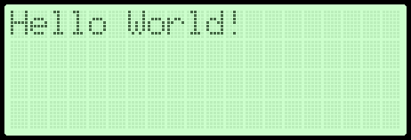
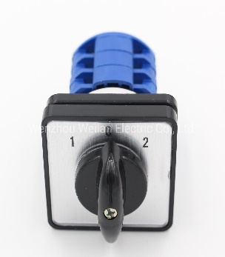
Programing: Transform the inputs to outputs
-Inputs
-Outputs
-
-
-

